Slide 1
Valuing American Options by Simulation - Least Square and Machine learning Approaches
Presented by: Jinyang Li
ACTSC 906 Final Project

Slide 2
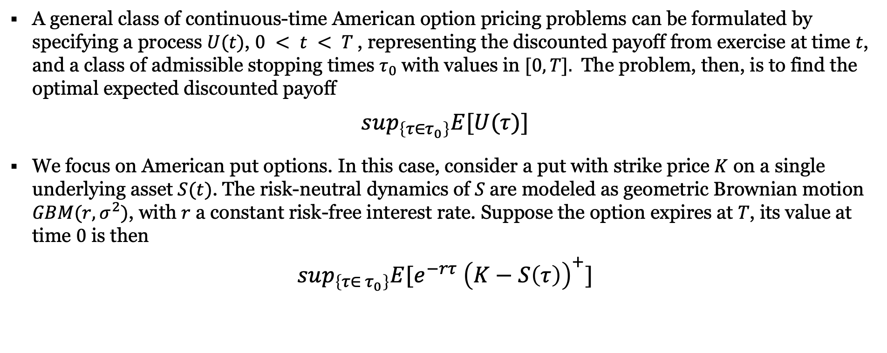
American option
OVERVIEW
A general class of continuous-time American option pricing problems can be formulated by specifying a process $U(t)$, $0 < t < T$, representing the discounted payoff from exercise at time $t$, and a class of admissible stopping times $τ_{0}$with values in $[0,T].$ The problem, then, is to find the optimal expected discounted payoff
$$sup_{\left\{τ∈τ_{0}\right\}}E[U(τ)]$$
We focus on American put options. In this case, consider a put with strike price $K$ on a single underlying asset $S(t)$. The risk-neutral dynamics of $S$are modeled as geometric Brownian motion $GBM(r,σ^{2})$, with $r$ a constant risk-free interest rate. Suppose the option expires at $T$, its value at time $0$ is then
$$sup_{\left\{τ∈ τ_{0}\right\}}E[e^{−rτ} {\left(K−S\left(τ\right)\right)}^{+}]$$

Slide 3
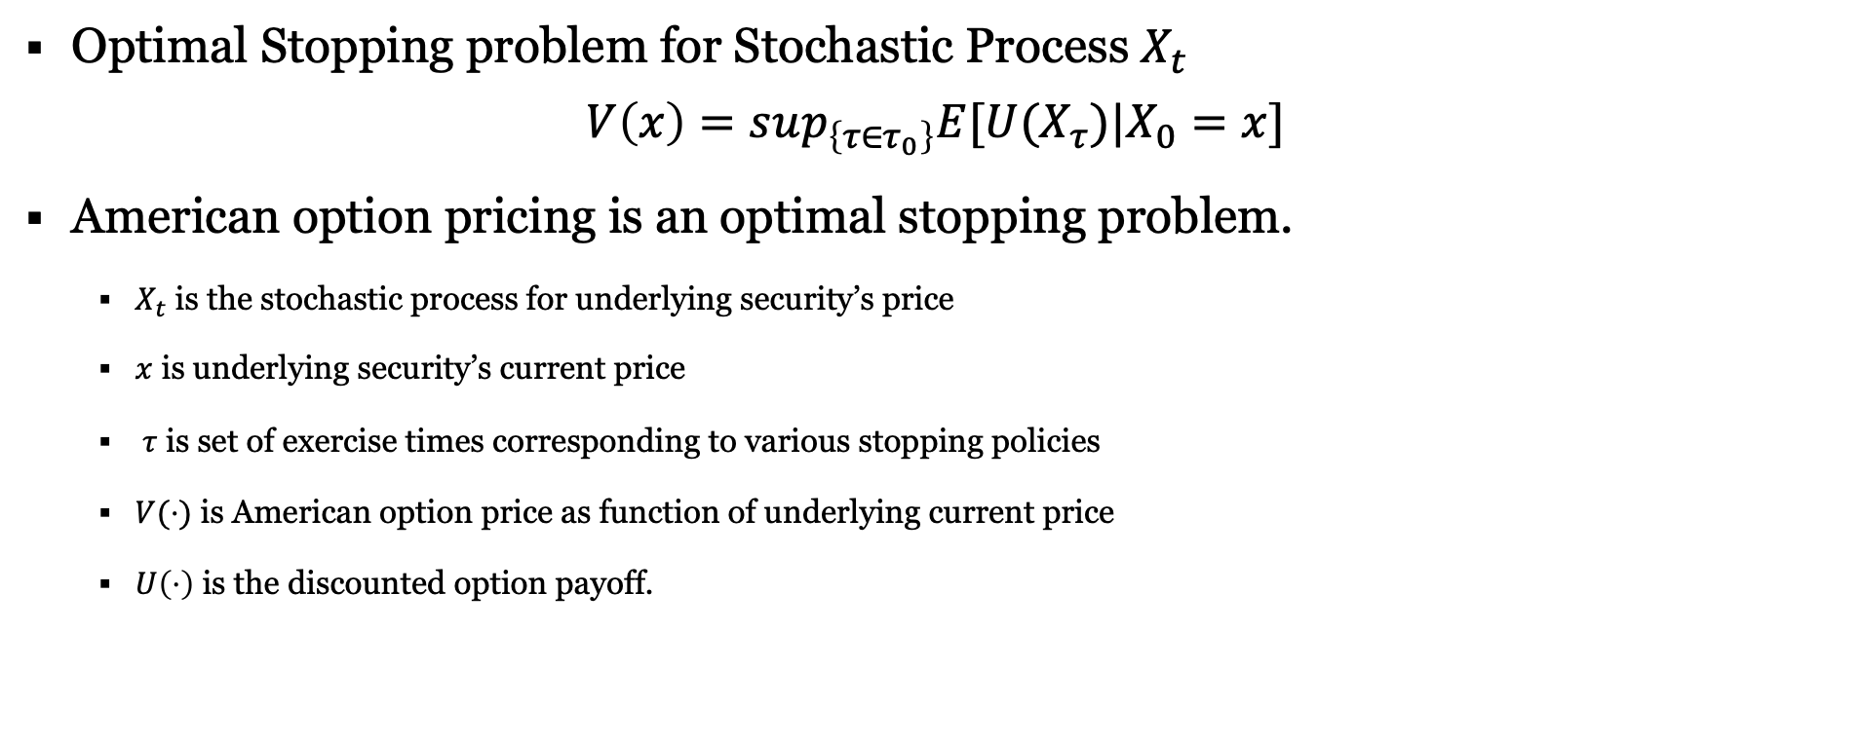
optimal stopping problem
OVERVIEW
Optimal Stopping problem for Stochastic Process $X_{t}$
$$V\left(x\right)=sup_{\left\{τ∈τ_{0}\right\}}E[U(X_{τ})|X_{0}=x]$$
American option pricing is an optimal stopping problem.
$X_{t}$ is the stochastic process for underlying security’s price
$x$ is underlying security’s current price
$τ$ is set of exercise times corresponding to various stopping policies
$V(⋅)$ is American option price as function of underlying current price
$U\left(⋅\right)$ is the discounted option payoff.

Slide 4
American option
OVERVIEW
Traditional ways
Black-Scholes: Due to the optimal stopping problem, this is technically impossible.
Lattice Tree
Finite difference
Monte Carlo
Machine Learning methods
Gaussian Process Regression
Lease Square Policy Iteration
Fitted Q-iteration

Slide 5
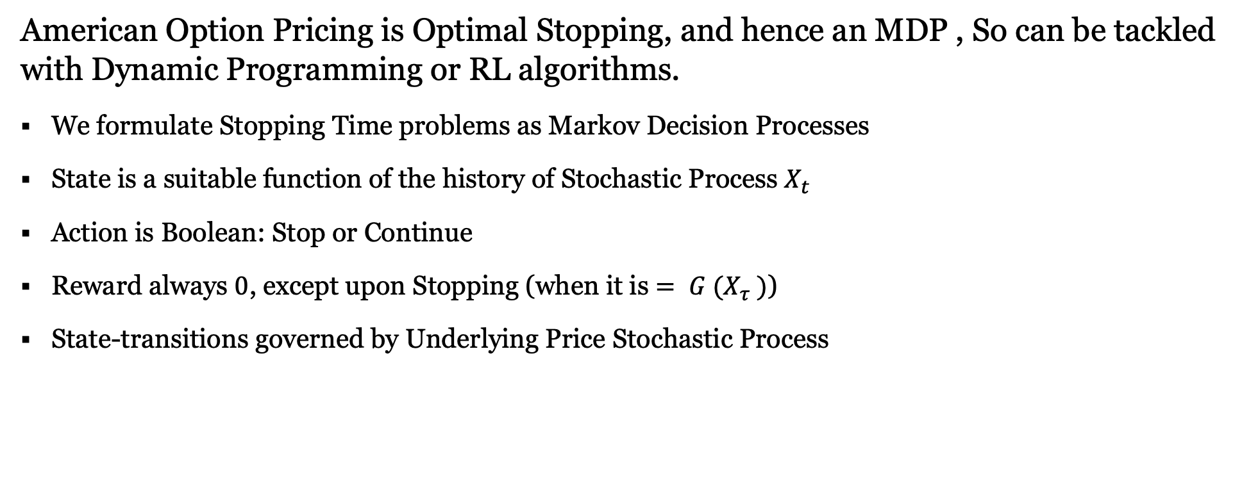
Markov Decision Processes
OVERVIEW
American Option Pricing is Optimal Stopping, and hence an MDP , So can be tackled with Dynamic Programming or RL algorithms.
We formulate Stopping Time problems as Markov Decision Processes
State is a suitable function of the history of Stochastic Process $X_{t}$
Action is Boolean: Stop or Continue
Reward always $0$, except upon Stopping (when it is $= G (X_{τ} )$)
State-transitions governed by Underlying Price Stochastic Process

Slide 6
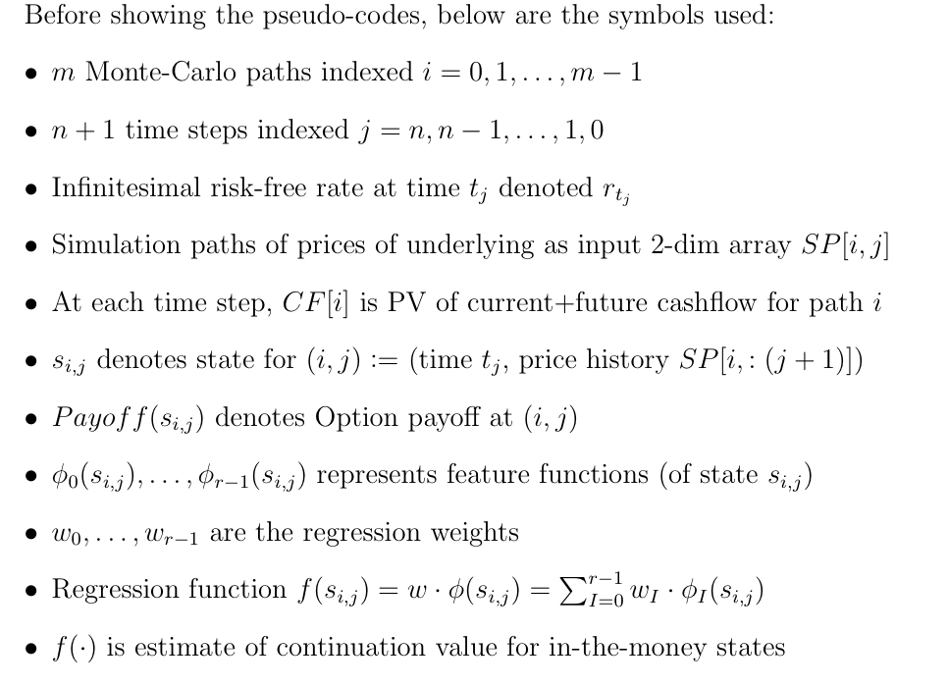
INGREDIENTS FOR APPROACHES
LSA

Slide 7
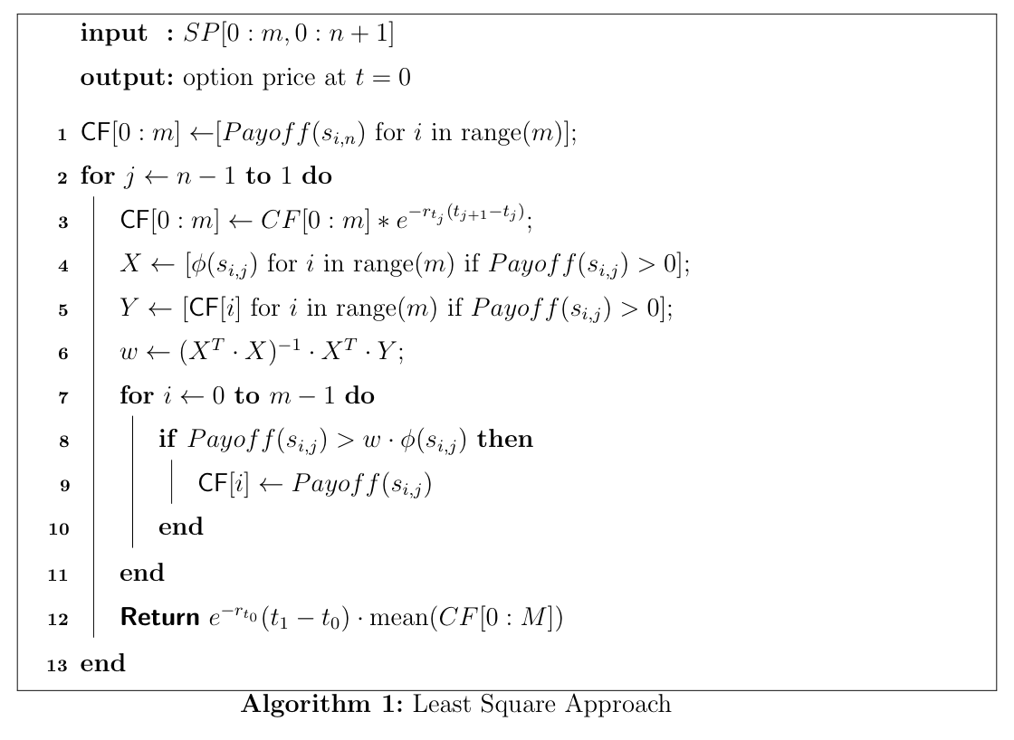
Longstaff-Schwartz algorithm
ALGORITHMS

Slide 8
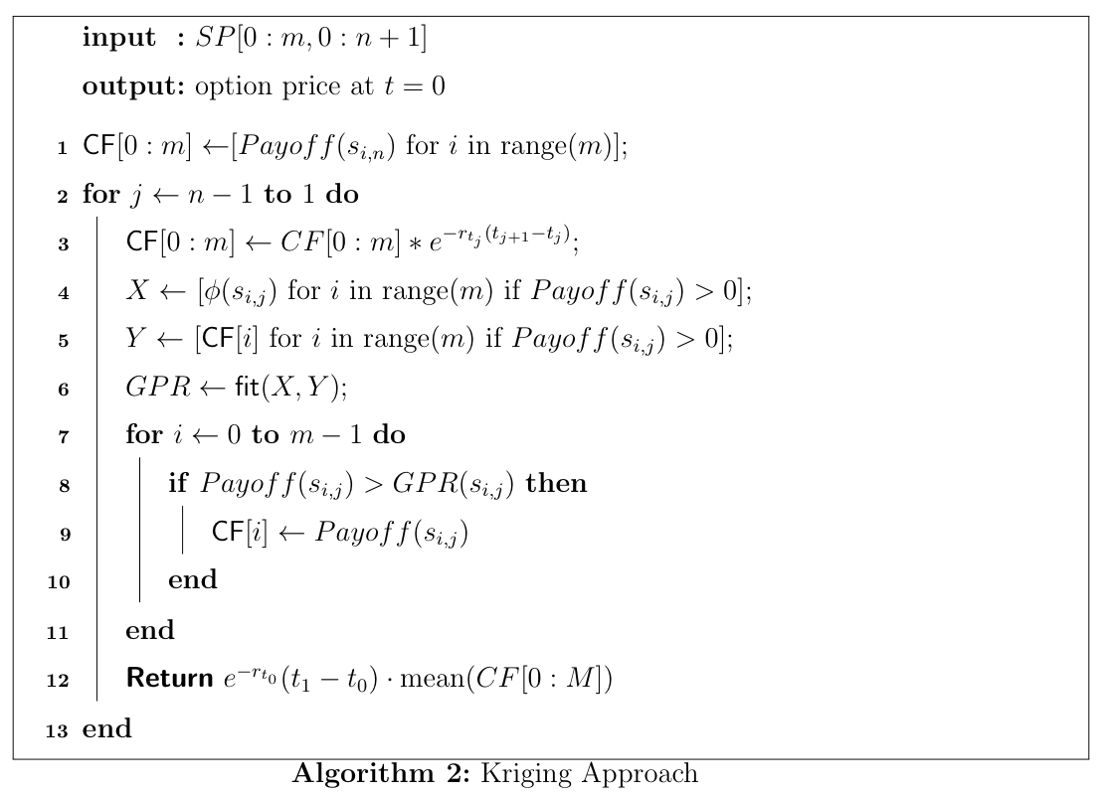
Gaussian process regression
ALGORITHMS

Slide 9
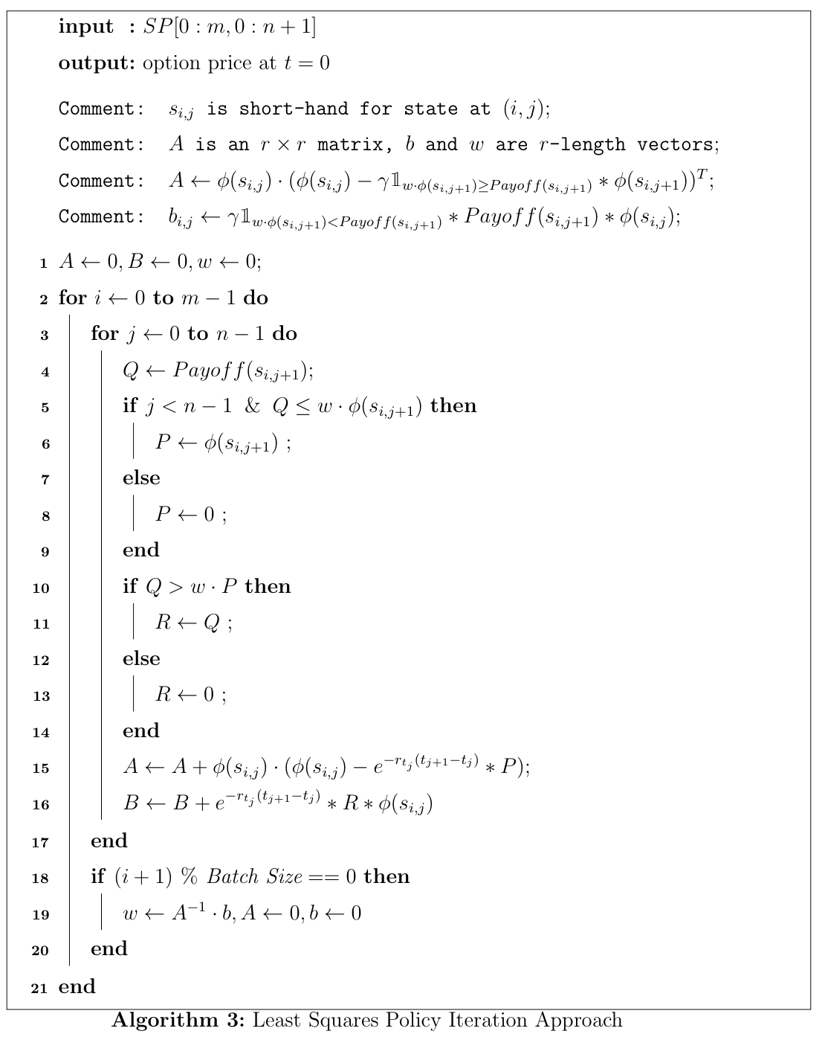
Least Squares Policy Iteration Approach
ALGORITHMS

Slide 10
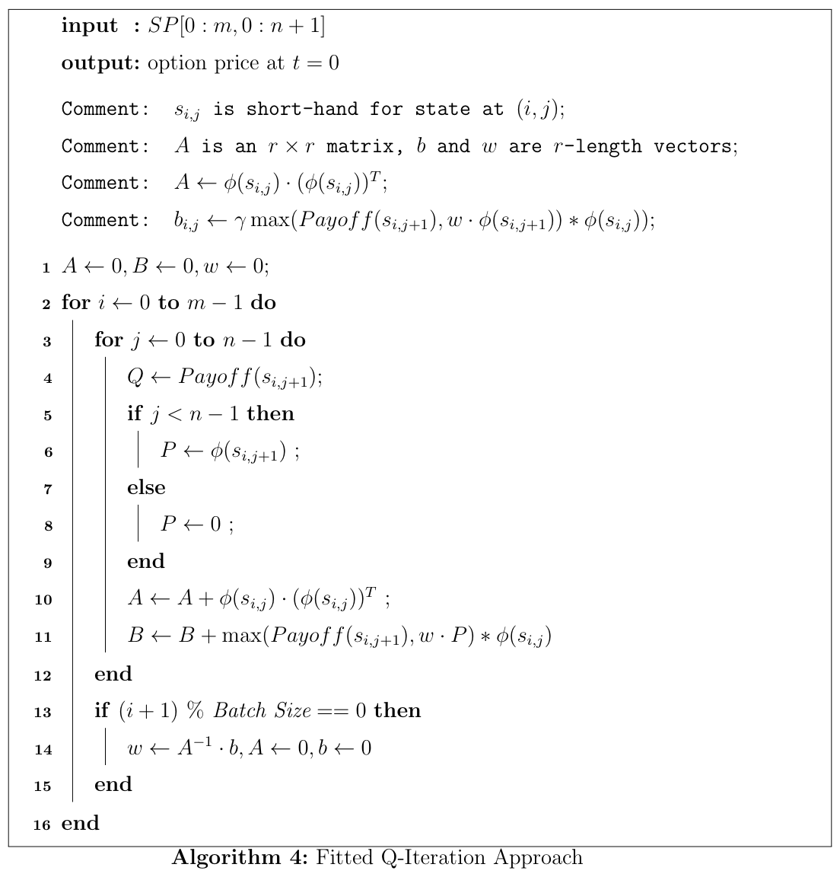
Fitted Q-Iteration Approach
ALGORITHMS

Slide 11
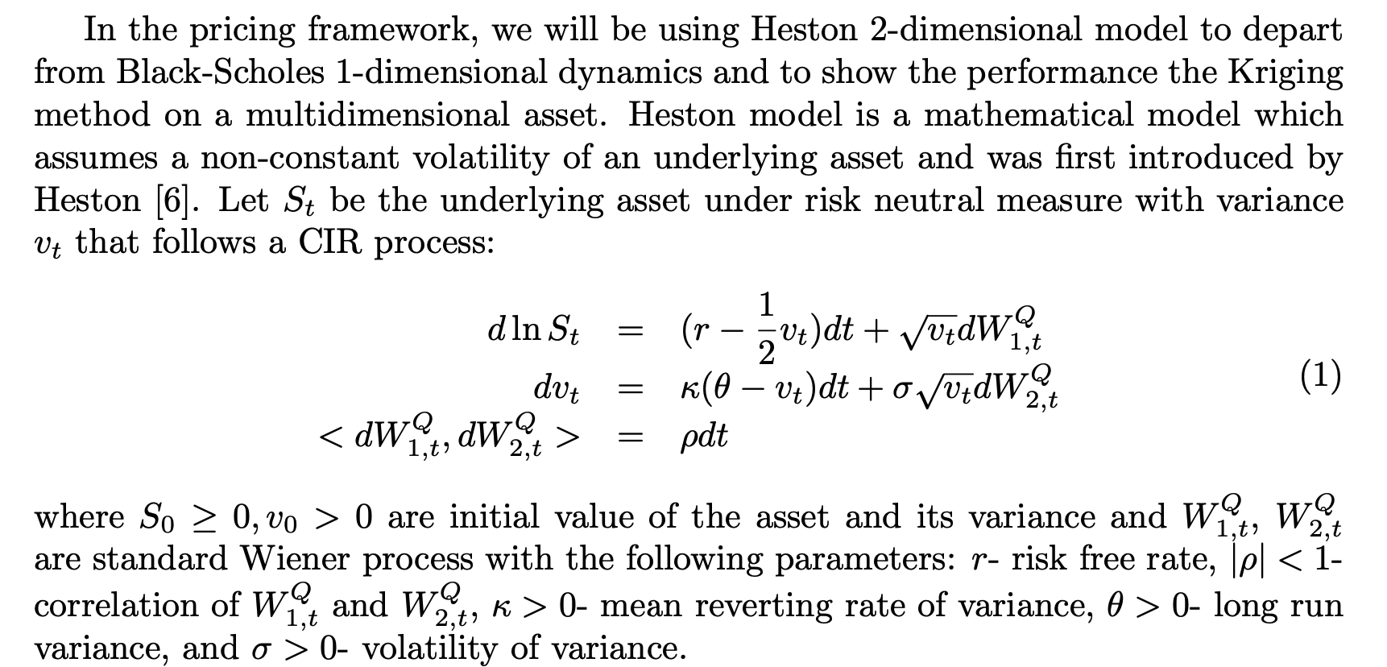
NUMERICAL EXAMPLES
ALGORITHMS
Simple American Put
Heston Model

Slide 12
simple AMERICAN PUT
Step 4
S0 | sigma | T | BS | LT | FD | LSM | GPR | FQI | LSPI
36 | 0.2 | 1 | 4.4840 | 4.48 (0.01%) | 4.46 (-0.44%) | 4.48 (0.02%) | 4.38 (-2.38%) | 4.38 (-2.37%) | 4.37 (-2.53%)
36 | 0.2 | 2 | 4.8501 | 4.85 (-0.08%) | 4.83 (-0.44%) | 4.83 (-0.31%) | 4.81 (-0.91%) | 4.85 (0.01%) | 4.79 (-1.15%)
36 | 0.4 | 1 | 7.1098 | 7.1 (-0.14%) | 7.08 (-0.47%) | 7.09 (-0.21%) | 6.8 (-4.38%) | 6.87 (-3.39%) | 6.78 (-4.64%)
36 | 0.4 | 2 | 8.5195 | 8.51 (-0.14%) | 8.49 (-0.40%) | 8.51 (-0.13%) | 8.2 (-3.70%) | 7.94 (-6.77%) | 8.22 (-3.56%)
38 | 0.2 | 1 | 3.2568 | 3.25 (-0.12%) | 3.24 (-0.64%) | 3.25 (-0.24%) | 3.14 (-3.47%) | 3.17 (-2.78%) | 3.01 (-7.46%)
38 | 0.2 | 2 | 3.7540 | 3.75 (-0.15%) | 3.73 (-0.54%) | 3.74 (-0.26%) | 3.65 (-2.90%) | 3.57 (-4.90%) | 3.67 (-2.17%)
38 | 0.4 | 1 | 6.1533 | 6.18 (0.44%) | 6.12 (-0.51%) | 6.13 (-0.30%) | 5.87 (-4.66%) | 5.89 (-4.28%) | 5.86 (-4.73%)
38 | 0.4 | 2 | 7.6713 | 7.69 (0.23%) | 7.65 (-0.34%) | 7.69 (0.20%) | 6.91 (-9.88%) | 6.89 (-10.13%) | 7.41 (-3.35%)
40 | 0.2 | 1 | 2.3245 | 2.31 (-0.49%) | 2.3 (-1.03%) | 2.31 (-0.58%) | 2.21 (-4.77%) | 2.25 (-3.08%) | 2.21 (-4.84%)
40 | 0.2 | 2 | 2.8965 | 2.89 (-0.39%) | 2.87 (-0.77%) | 2.89 (-0.23%) | 2.58 (-10.88%) | 2.55 (-11.94%) | 2.77 (-4.21%)
40 | 0.4 | 1 | 5.3260 | 5.3 (-0.44%) | 5.29 (-0.74%) | 5.32 (-0.21%) | 5.1 (-4.32%) | 5.08 (-4.68%) | 5.1 (-4.30%)
40 | 0.4 | 2 | 6.9351 | 6.91 (-0.31%) | 6.89 (-0.60%) | 6.94 (0.04%) | 7.05 (1.60%) | 6.86 (-1.06%) | 7.32 (5.51%)
42 | 0.2 | 1 | 1.6204 | 1.62 (0.22%) | 1.61 (-0.94%) | 1.62 (-0.10%) | 1.59 (-1.94%) | 1.59 (-1.94%) | 1.6 (-1.13%)
42 | 0.2 | 2 | 2.2187 | 2.22 (-0.07%) | 2.2 (-0.71%) | 2.23 (0.31%) | 1.86 (-16.38%) | 1.85 (-16.70%) | 2.06 (-7.24%)
42 | 0.4 | 1 | 4.5884 | 4.61 (0.55%) | 4.56 (-0.67%) | 4.59 (0.10%) | 4.43 (-3.38%) | 4.41 (-3.91%) | 4.43 (-3.36%)
42 | 0.4 | 2 | 6.2464 | 6.26 (0.29%) | 6.22 (-0.42%) | 6.27 (0.38%) | 5.65 (-9.60%) | 5.3 (-15.17%) | 5.96 (-4.63%)
44 | 0.2 | 1 | 1.1118 | 1.12 (0.84%) | 1.1 (-1.02%) | 1.12 (0.30%) | 1.12 (0.65%) | 1.13 (1.30%) | 1.09 (-1.82%)
44 | 0.2 | 2 | 1.6921 | 1.7 (0.31%) | 1.68 (-0.62%) | 1.69 (0.17%) | 1.43 (-15.38%) | 1.33 (-21.44%) | 1.47 (-13.36%)
44 | 0.4 | 1 | 3.9529 | 3.96 (0.22%) | 3.92 (-0.72%) | 3.96 (0.17%) | 3.87 (-2.12%) | 3.86 (-2.29%) | 3.87 (-1.98%)
44 | 0.4 | 2 | 5.6511 | 5.65 (0.01%) | 5.62 (-0.62%) | 5.67 (0.26%) | 4.93 (-12.76%) | 4.64 (-17.83%) | 5.29 (-6.41%)

Slide 13
simple AMERICAN PUT option
Step 4

Slide 14
Summary
The non machine learning method is more stable and efficient in time.
The machine learning method is fair enough but needs a lot of parameter tuning. Takes longer time and may result in fluctuated estimation.
Machine learning performs better when it is in high-dimensional case, but still, much slower than the mainstream way.
Future work:
Control variate
Low discrepancy points.

Slide 15
Thanks for listening

